Slide 1
IMAGE PROCESSING BASED DETECTION OF COUNTERFEIT INDIAN BANK NOTES

Slide 2
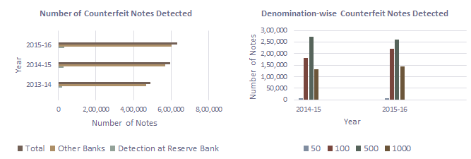
Motivation
Counterfeit currency is a burning question throughout the world.
The counterfeiters are becoming harder to track down because of their rapid adoption of and adaptation with highly advanced technologies.
According to the annual report by RBI, during the year, 632,926 pieces of counterfeit notes were detected in the banking system, of which 95 per cent were detected by commercial banks.
Fig. 1. Statistics on detected counterfeit banknotes.
The existing solutions to solve the counterfeit problem though effective are either computationally complex, hardware based, expensive or inaccessible to the common people. Hence we propose a cost effective and robust automated counterfeit currency detection tool exploiting image processing techniques.

Slide 3
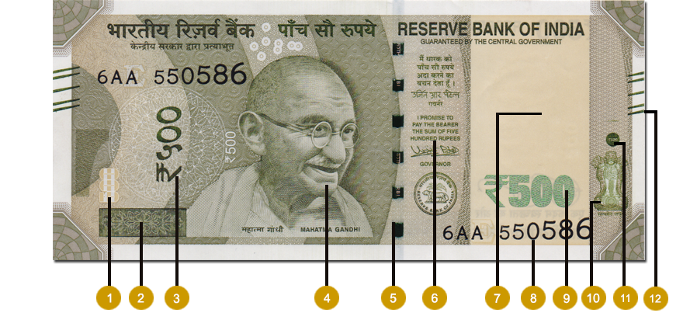
Background
Various security features are incorporated into the banknotes to protect them against counterfeiting. Thus, the authenticity of a genuine currency note is predicated on the basis of these security features.
See through Register
Latent Image
Devanagari Script
Portrait of Mahatma Gandhi
Security Thread
Guarantee Clause
Electrotype Watermark
Number Panel
Denominational Number
Ashoka Pillar
Circle with 500 raised(Rectangle for ₹ 2000)
Bleed lines

Slide 4
Objectives
The ₹ 500 note is considered for study as it is the most susceptible and prone to falsification.
The following security features, being abstract and intricate in their design are difficult to replicate and hence are used to determine if the note is counterfeit :
Security Thread
Latent Image

Slide 5
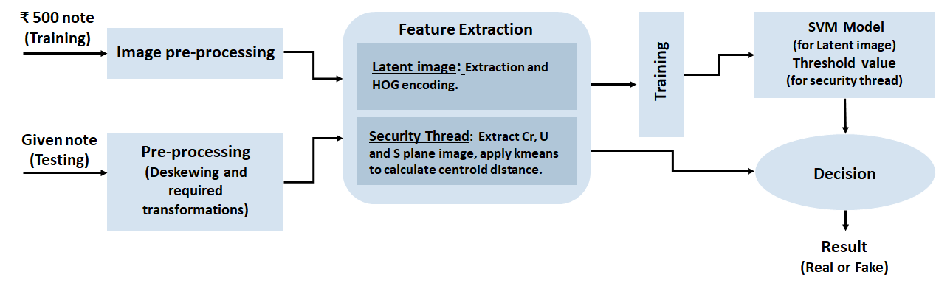
Methodology

Slide 6
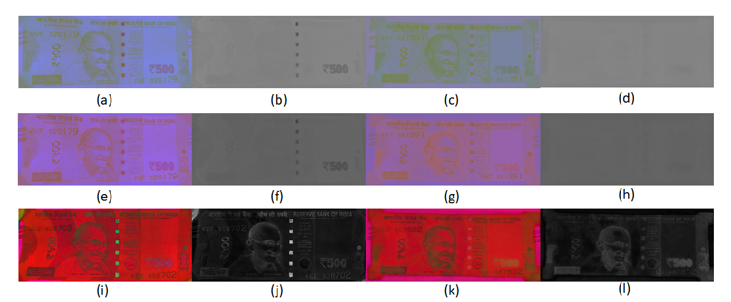
Results and Conclusion
Total test images | Performance Parameters
 | True positive | True negative | False positive | False negative | Accuracy (%)
30 | 20 | 9 | 0 | 1 | 96.67

Slide 7
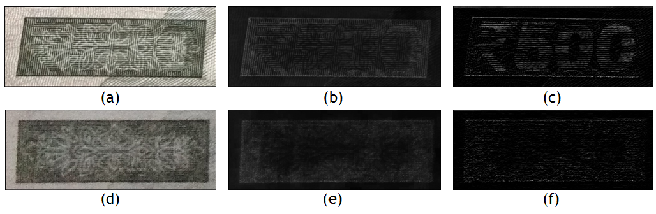
Results and Conclusion
Total test images | Performance Parameters
 | True positive | True negative | False positive | False negative | Accuracy (%)
30 | 20 | 10 | 0 | 0 | 100

Slide 8
Scope
This novel and unique image processing based approach makes use of only a camera to determine the legitimacy of Indian banknotes.
The absence of special hardware components like UV scanner make it compact and mobile.
Hence this cost effective tool can be readily utilized in smart phones, making it easily accessible to the public.
However in spite of above mentioned merits, 100% accurate result is difficult to obtain.

Slide 9
References
1) https://rbi.org.in
2) A. Vila, N. Ferrer, J. Mantec´on, D. Bret´on, J.F. Garc´ıa, “Development of a fast and non-destructive procedure for characterizing and distinguishing original and fake euro notes”, A. Vila et al. / Analytica Chimica Acta 559 (2006).
3) M. Uddin, P. Das, S. Roney, “Image-Based Approach for the Detection of Counterfeit Banknotes of Bangladesh”, International Conference on Informatics, Electronics and Vision 2016.
Images courtesy :
Fig. 1 - https://rbi.org.in

Slide 10
Thank you ☺

Slide 11
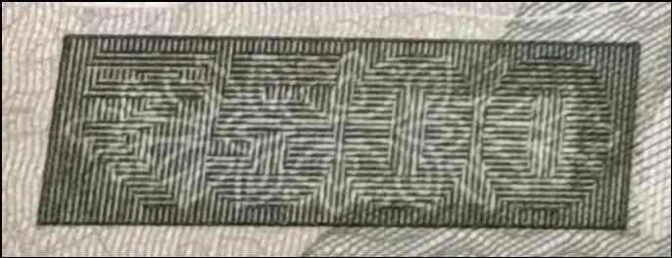
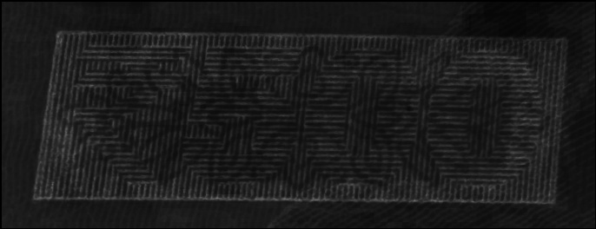


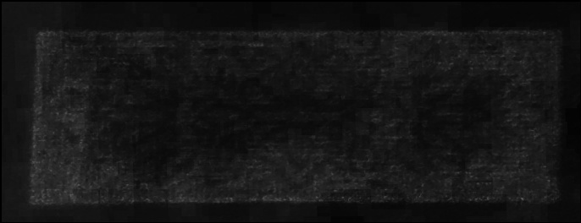
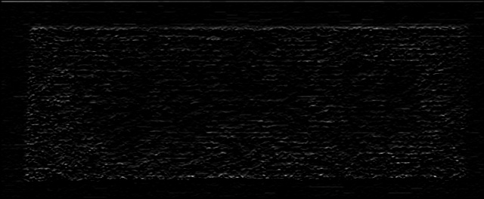
(a)
(b)
(c)
(d)
(e)
(f)

